Slide 1
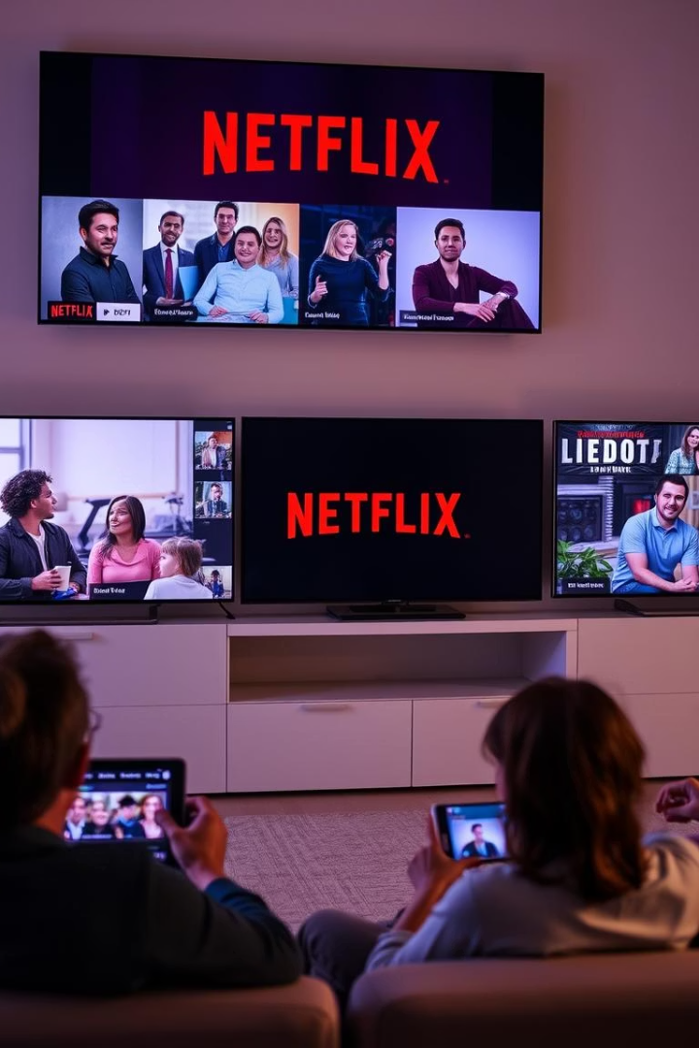
Netflix Audience & Content Insights Report
Objective: To analyze Netflix's content performance and customer engagement for strategic insights across demographics, regions, subscriptions, and genres.
by Abubakkar Siddiq

Slide 2








Audience Engagement Analysis
Middle-Aged (31-45)
Young Adults (19-30)
21.97% of watch time
17.62% of watch time
Mature Audiences (46+)
Teens (13-18)
Over 51% of total engagement
8.73% of watch time
Viewership is skewed toward mature audiences (46+), who account for over 51% of total engagement. Younger users (under 30) contribute only ~26.3% of watch time, indicating potential gaps in content appeal or marketing effectiveness for this demographic.

Slide 3











Age Group Distribution
Age 60+
29.36% (~15M minutes)
Age 46-60
22.06%
Age 31-45
21.97%
Age 19-30
17.62%
Age 13-18
8.73%

Slide 4
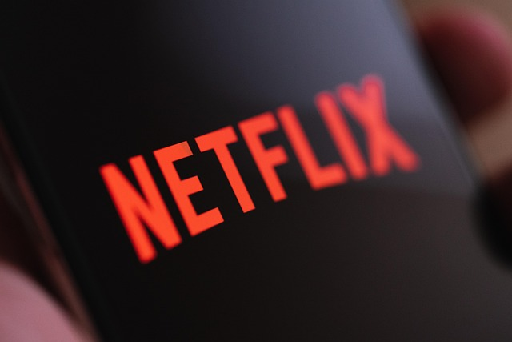
Subscription Tier Market Share
34.28%
32.98%
32.75%
Standard
Basic
Premium
Largest subscription tier
Mid-range subscription tier
High-end subscription tier
Near-even distribution across tiers highlights a well-balanced user base.

Slide 5




Watch Time by Subscription Tier
Standard
Basic
Premium
Leads in total watch time
Second in total watch time
Third in total watch time
Engagement across tiers is consistent, suggesting similar usage patterns regardless of plan.

Slide 6
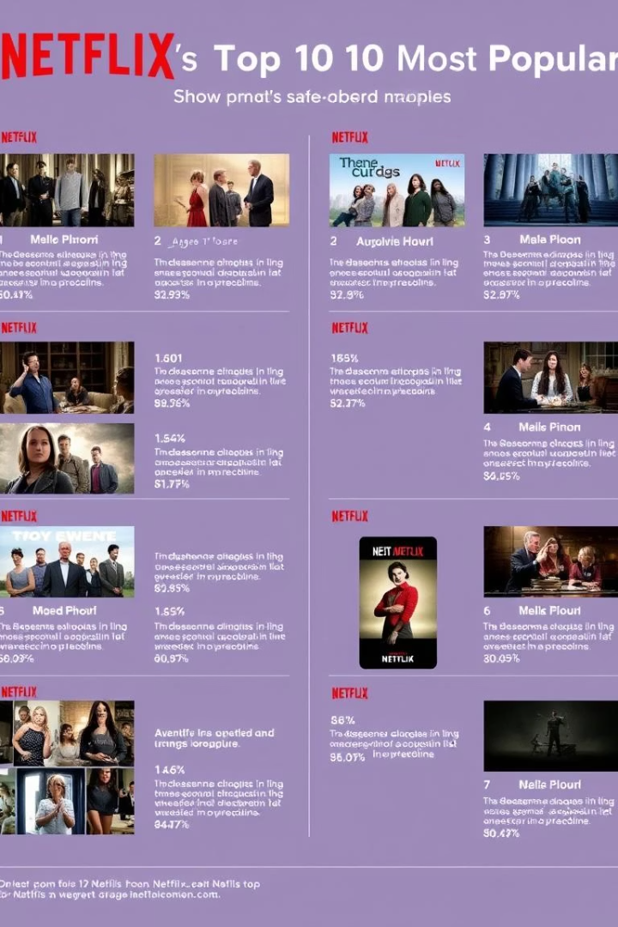
Geographic Subscription Patterns
France
Germany
Shows strong Standard tier uptake (733 subscribers)
Shows strong Standard tier uptake (720 subscribers)
Balanced distribution across other tiers
Similar pattern to France with balanced distribution
Global Trends
Globally balanced distribution across all tiers
Standard tier holds a slight lead worldwide

Slide 7


TV Shows vs. Movies
Even Watch Time Split:
Movies: 50.49%
TV Shows: 49.51%
Indicates parity in user preference—Netflix should continue investing equally in both formats.

Slide 8

Top 10 Most Watched Titles
Rank
Title
Watch Time
1
Place Nice
29K mins
2
Half Property
26K mins
3
Interesting Pattern
~23K mins
4
Culture Gun
~23K mins
5
Over Material
~23K mins
6-10
Others (e.g., Phone)
21-22K mins

Slide 9

Top Genre Preferences & Ratings
Most Watched
Thriller, Romance, Sci-Fi, Drama, Fantasy dominate viewership.
Least Watched
Animation and Horror receive lower watch counts across markets.
Highest Rated
Action (3.26), Fantasy (3.23), Animation (3.19) lead in ratings.
Lowest Rated
Documentary (2.84), Horror, and some Fantasy formats lag.

Slide 10



Regional Genre Preferences
France
India
Strong preference for Drama content; highly engaged audience.
Sci-Fi and Action genres resonate most with Indian viewers.
USA
Balanced consumption pattern across genres and formats.
Comparing TV Shows and Movies
TV Shows
Movies
Earn higher average ratings across most genres.
Drive greater total watch count despite lower ratings.

Slide 11




Ratings & Quality Analysis
Country-wise Genre Ratings
Recent vs. Older Content
Top Rating Nations: Japan, India, France
No significant difference; both average ~3.0 rating.
Stricter Raters: Germany, South Korea
Quality perception remains consistent over time.
Monthly Ratings Trend
July: 3.075, March: 3.047, October: 3.047
June: 2.951, December: 2.952

Slide 12

Ratings by Genre
3.26
3.23
Action
Fantasy
Highest rated genre
Second highest rated
3.19
2.84
Animation
Documentary
Third highest rated
Lowest rated genre
Highest Rated: Action (3.26), Fantasy (3.23), Animation (3.19) • Lowest Rated: Documentary (2.84), Horror, and sometimes Fantasy (in certain formats)

Slide 13














Geographic Insights
India
France
5.2M mins
5.2M mins
USA
UK
~5M mins
~4.8-4.9M mins
Canada
~5M mins
South Korea
Germany
~4.8-4.9M mins
~5M mins
Total Watch Time by Country
• Top Markets: France & India: 5.2M mins, USA, Canada, Germany, Australia, Japan, Brazil: ~5M mins
• Trailing Markets: South Korea, UK: ~4.8–4.9M mins

Slide 14





Content Availability
Content Availability • Fairly even across countries (10% each). • Germany leads slightly in number of titles.
Germany
1
Slightly higher title count
Most Countries
Equal distribution (10% each)
Global Balance
Fairly even content availability

Slide 15

Director Impact
Top-Rated Directors (5.0 Ratings)
Aaron Kelley
Amanda Wall PhD
Amber Cooper
Likely small-sample films or niche content with high appreciation.
Overall Director Rating
Average across all: 3.01
Suggests viewer ratings of directors are polarized but collectively neutral.

Slide 16





Temporal Patterns
October
1785 shows watched per customer
Peak engagement month
March
1778 shows watched per customer
Second highest engagement
August
1725 shows watched per customer
Third highest engagement
September
1561 shows watched per customer
Lowest engagement month
Insight: Peak engagement occurs in October, March, and August—ideal for launching major titles or promotional campaigns.

Slide 17





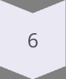


Strategic Takeaways & Recommendations
Double Down on Older Audiences
The 60+ demographic is Netflix's core audience. Target content, ads, and features specifically for this age group.
Balance Movies and TV Shows
Continue offering diverse content formats—viewers engage equally with both.
Invest in Top Genres
Thriller, Romance, Sci-Fi, Action perform best globally. Prioritize content development and acquisition in these categories.
Capitalize on High-Performing Countries
France and India lead in both consumption and ratings. Focus localization, subtitling, and market outreach efforts here.
Leverage Standard Tier Dominance
Standard plan users are most active. Introduce feature upgrades or loyalty perks to encourage upsells to Premium.
Use Peak Months Strategically
Align major content drops and campaigns with October, March, and August to maximize reach.
Curate by Director Reputation
Feature highly rated directors for niche content collections; monitor for rising talent with consistently strong feedback.
Monitor Genre-Specific Rating Trends
Prioritize high-rated genres (e.g., Action, Drama) and avoid over-investment in lower-rated ones (e.g., Documentary, Horror).

